Slide 1
Evidence based policy making from the statistical perspective
Juraj Riečan
Director – retired, UN-ESCWA Statistics Division

Slide 2
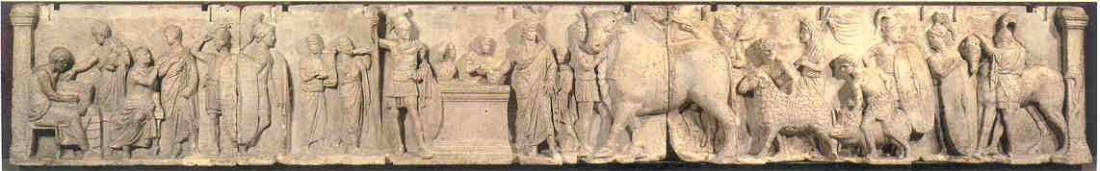
OFFICIAL STATISTICS
Statistics published public bodies such as
government and international organizations as a
public good
Thousands of years of accumulated wisdom
Developed scientific methods for data processing and analysis
Longitudinal time series
Fundamental Principles of Official Statistics

Slide 3



DATA REVOLUTION
Explosion in the volume and production of data matched by a growing demand for data from all parts of society (Independent Expert Advisory Group)

Slide 4
DATA REVOLUTION
Delivering the right data to the right people in the right format at the right time (PARIS21)
Policy makers
Economic leaders and entrepreneurs
Civil society
Researchers, academia
Private citizens

Slide 5
Taking informed decisions
Formulating policies
Monitoring policy implementation
Assessing impact of policies
Updated and new policies
Decision making in the economic, social and environmental sectors
Research studies, publications, media articles based on data
Everyday decisions by everyone

Slide 6
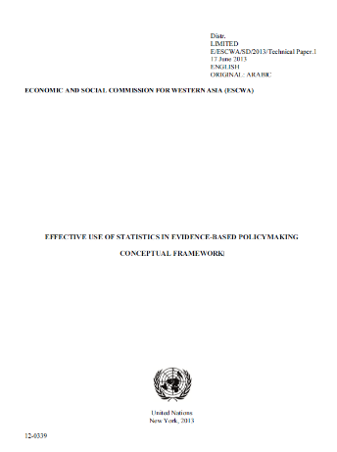

UN-ESCWA Guidelines
E/ESCWA/SD/2013/Technical Paper 1
https://www.unescwa.org/publications/effective-use-statistics-evidence-based-policymaking-conceptual-framework

Slide 7
Evidence components
Ability
Approach
Availability of sufficient evidence
Data quality
Timeliness
Provision of trusted evidence
Independence
Transparency
Environment conductive to policy making
Evidence based policies

Slide 8






Public policy cycle
2. Policy analysis
1. Identify issues
3. Present options and analysis
5. Monitoring and evaluation
4. Decision on
policy development and implementation

Slide 9
Statistical cycle
Specify needs
Design
Build
Collect
Process
Analyse
Disseminate
Generic Statistical Business Process Model (GSBPM)
Evaluate

Slide 10
Statistical input in a policy cycle
Public policy cycle
Statistical Inputs
Determining the issues
Policy analyses
Solutions
Monitoring and evaluation

Slide 11
Economic statistics concepts
System of National Accounts (2008 SNA)
  Gross Domestic Product (GDP)
  Classification of all economic activities (ISIC Rev. 4)
External trade
  Standard International Trade Classification (SITC Rev. 4)
  Harmonised System (HS Rev. 2022)
Cross domain:
  Central Product Classification (CPC Ver. 2.1)

Slide 12
Disaster reduction concept
Sendai Framework on disaster risk reduction
  Disaster related mortality
  Number of people affected by disasters
  Direct economic loss in relation to GDP
  Damage to critical infrastructure
  Number of countries/local governments with disaster risk strategies
  ODA and other support to implementation of the disaster risk reduction framework
  Number of countries/local governments with early warning systems

Slide 13
Multi domain concepts
Sustainable Development Goals Indicators (SDG indicators)
  231 indicators (248 on the list with repetitions)
  Structured per goals and targets
  Defined by the IAEG-SDG – with the decisive involvement of national statistical offices
Positive:
  A complex picture of sustainable development
  Gives structure to domains without own structured indicators set
Negative:
  Too many indicators as opposed to the ambition
  Non-availability of data for some countries/indicators

Slide 14
Example of a multi-purpose indicator
Maternal mortality
  Direct health situation measurement
  Broader indication of a level of social development
  Gender related indictor
Note: gender related indicators
  Gender sensitive indicators
    Measurement of changes in relation between women and men
    Changes in the status of the of women
  Sex disaggregated indicators (women/men/total)
  show only part of the picture

Slide 15
Example of a multi-purpose indicator
Proportion of households with sewage
  Direct housing quality measurement
  Broader indication of economic development
  Broader indicator of environment protection
Consumption of electric energy by source
  Energy efficiency measurement
  Pollution related indicator

Slide 16
Data from emerging sources
Call detailed records
  Lebanon: situation of Syrian refugees compared to the host community:
    Movement of mobile phones (MTC Touch Al Tawasol)
    Length of call
    Pattern of use of other mobile services
  Statistical results:
    Economic situation
    Mobility
    Gathering areas – residential, work,…
    Estimated number of refugees in Lebanon
Complemetary with VASyR and concept validation

Slide 17
Data from emerging sources
Global Database of Events Language and Tone
(GDELT)
Twitter (anonymized) records
  Public opinion
  Lebanon: Host community’s acceptance of refugees
  Lebanon and Jordan: Effectiveness and impact of Covid-19 policies

Slide 18
Data from emerging sources
Satellite imagery
  Google Earth and private providers
  Land use and land cover
    Agricultural land, urban areas, etc.
  Production of illicit drugs (UNODC – Afghanistan)
    Monitoring poppy fields
  Jordan impact of Covid-19 curfew – reduction of night lights
    Mobility pattern – respect of curfew
    Concentration of population
    Changes in activity pattern

Slide 19
Are data important in decision making?
Let’s look just 2-3 years ago. Following the outbreak of Covid-19 and a fast emerging decisions on restrictions and lockdowns, everybody with access to the Internet looked at websites showing data on Covid-19 prevalence.
Throughout the same period the policy makers followed data on the economic consequences of restrictions, in taking measures to prevent a collapse and a social crisis – and this continues until these days.

Slide 20
Examples of data use
Consumer price index
  Adjustments of retirement benefits
  Periodic increase in rental contracts
  Setting up minimum wages and income
  National statistical offices have a legal obligation to regularly publish the CPI
UN place to place surveys
  Adjusting salaries to the cost of living differences
  Travel allowances
  UN costs of living data are shared with governments and other organizations

Slide 21
Examples of data use
Prevalence of transmissible diseases
  Vaccination strategies
  Immediate measures to prevent the spread of diseases
Trade balances
  Agreements and decisions on tariffs and quotas
  Measures to support exports
  Strategies to decreases imports dependence

Slide 22
Bahrain – labour market regulation
Bahrainisation quotas set for economic activities
  Structured according to ISIC classification
  Sources: Labour Force Surveys and Household Income and Expenditure Surveys
Linking the registration of
  Central Information Organization
  Population register
  Ministry of interior - visas
  Labour Market Regulatory Authority
  Chamber of Commerce
Used in granting work visas and work permits

Slide 23

Lebanon CPI
Published (monthly) by the Central Administration for Statistics (CAS)
Developed in cooperation with IMF
Total CPI and breakdowns
  By governorates
  By commodities
Example rent:
  Old rent
  New rent
  Commercial rent

Slide 24
Purchasing Power Parities
International comparison
  Based on comparable baskets of approx. 3000 goods and services
  Eliminating the effect of price level differences
  Expressed in USD :
      PPP = basket value in national currency / basket value in USD
  Total and a breakdown by commodities
  Used in international comparisons (examples):
    Economy: Comparison of GDP
    Social: Comparison of private income and expenditure
  ICP: World Bank and regional implementation agencies in 6 regions

Slide 25

Purchasing Power Parities in the Arab region
UN-ESCWA is the regional implementation agency of the ICP
Updated and published annually
Expressed in Omani Riyal (OMR)
Harmonized with Africa
Regional data are used
for the global ICP

Slide 26
Understanding data
- statistical literacy
Capacity to collect, analyse and disseminate data
Statistical legislation
Modernizing data systems
International standards applicable to data
Combining administrative and survey sources
Exploring new data sources
Manage data flow and facilitate data reporting
Statistical data and metadata exchange and sharing
Guiding policy makers in understanding statistical data

Slide 27


Harmonized data presentation
Classification of Statistical Activities (CSA 2.0)
SDMX Domain Classification

Slide 28
Statistical Domain classifications
Demographis and social statistics
Economic statistics
Environment statistics
Governance statistics
Cross-cutting statistics
Statistical infrastructure and methodology
Strategic and managerial issues

Slide 29
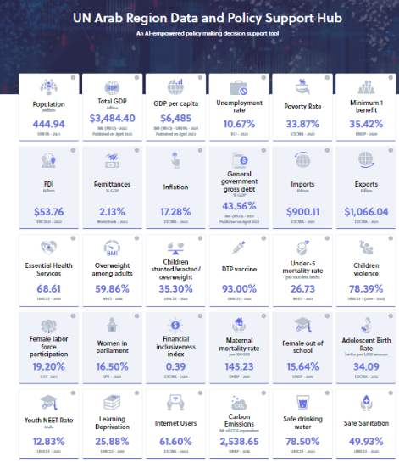
Example of a data hub

Slide 30

Fundamental Principles of Official Statistics
1. Relevance, impartiality and equal access
2. Professional standards and ethics
3. Accountability and transparency
4. Prevention of misuse
5. Sources of official statistics
6. Confidentiality
7. Legislation
8. National coordination
9. Use of international standards
10. International cooperation

Slide 31

Adoption of the
Fundamental Principles
1992 – Adopted by the
UNECE annual session
1994 – Adopted by the
UN Statistical Commission
2013 – Adopted by the
UN-ECOSOC
2014 – Adopted by the
UN General Assembly
A/RES/68/261

Slide 32

Juraj Riečan ex-Director, UN-ESCWA Statistics Division
juraj@riecan.eu
https://linkedin.riecan.eu
https://facebook.riecan.eu

